Slide 1


Dynamics insights for SMB Partners
Madrid 2017

Slide 2


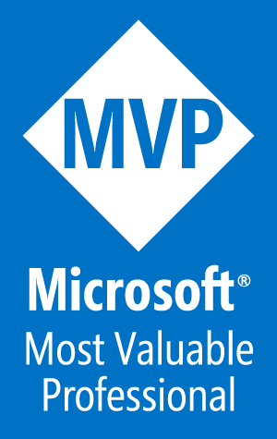



Business Solutions MVP
@jordimontana
GitHub: jordimontana82
Blog:
https://dynamicsvalue.com/blog
Test Automation for Dynamics 365
Simplify unit testing of Dynamics 365 solutions
Jordi Montaña
@jordimontana
Founder & Director at
DynamicsValue
jordimontana82

Slide 3
Session objectives
1
Why unit testing is important in Dynamics 365
2
Why FakeXrmEasy
3
Learn how to unit test the backend of MVC web portals
4
Learn how to unit test plugins & codeactivities

Slide 4

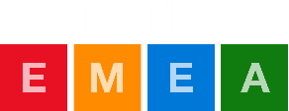
Why Unit Testing?

Slide 5
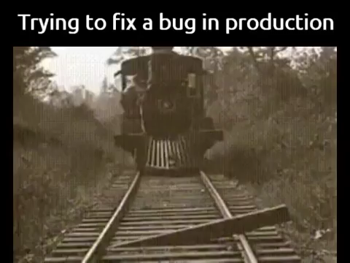
Why Unit Testing?

Slide 6
Why Unit Testing?
Unit Testing
Functional Testing
Business Testing (UAT)
Production
Unit Testing
Functional Testing
UAT
Production

Slide 7
Why Unit Testing?
Developers
Unit Testing
Functional Testing
Business Testing (UAT)
Production
Unit Testing
Functional Testing
UAT
Production

Slide 8
Why Unit Testing?
Developers
Testers
Unit Testing
Functional Testing
Business Testing (UAT)
Production
Unit Testing
Functional Testing
UAT
Production

Slide 9
Why Unit Testing?
Developers
Testers
End Users
Unit Testing
Functional Testing
Business Testing (UAT)
Production
Unit Testing
Functional Testing
UAT
Production

Slide 10
Why Unit Testing?
Developers
Testers
End Users
Really Angry End Users
Unit Testing
Functional Testing
Business Testing (UAT)
Production
Unit Testing
Functional Testing
UAT
Production

Slide 11
Why Unit Testing?
You find issues much earlier in the development lifecycle
Automated regression testing
Builds confidence
Reduces maintenance

Slide 12
Why FakeXrmEasy?

Slide 13
Why FakeXrmEasy?
XRM / CRM SDK is mainly composed of the following:
CRUD operations
Query Engine
CRM Messages (i.e. SetStateRequest)

Slide 14
Problems with existing .NET mocking frameworks
Started in 2014 facing some problems…
Generic & Complex
Mocking Queries is REALLY hard
Loads of CRM messages to mock

Slide 15
Problem #1: Complexity
Mocking a single service.Create() with Moq looks like:
var mock = new Mock<IOrganizationService>();
mock.Setup(service => service.Create(It.IsAny<Entity>()))
.Callback((Entity e) => {
e.Id = id;
entities.Add(e); })
.Returns((Entity e) => id);

Slide 16
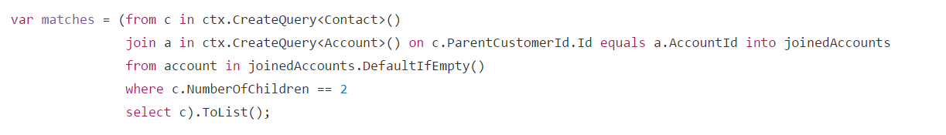
Problem #2: Mocks ignore filters / joins…

Slide 17
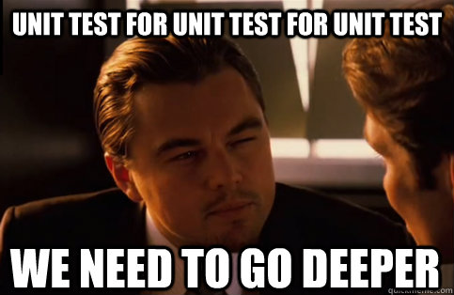
Problem #3: A single .Execute() method with a bunch of messages to mock…

Slide 18
So… Unit Testing for Dynamics 365 would be amazing if…

Slide 19
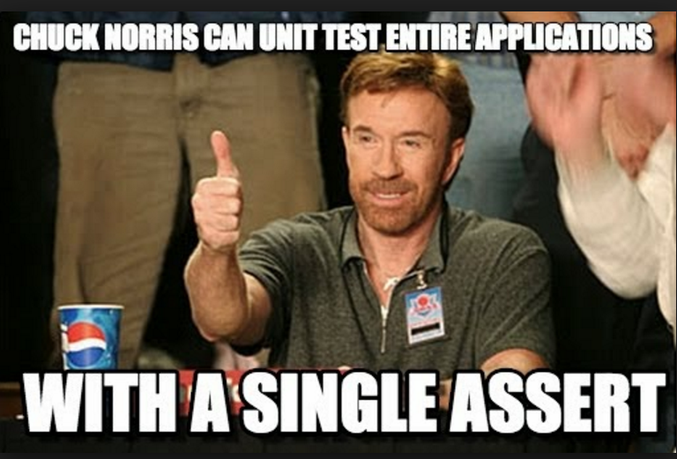
…everything was already mocked for us, by default

Slide 20
So… FakeXrmEasy was born in 2014…

Slide 21
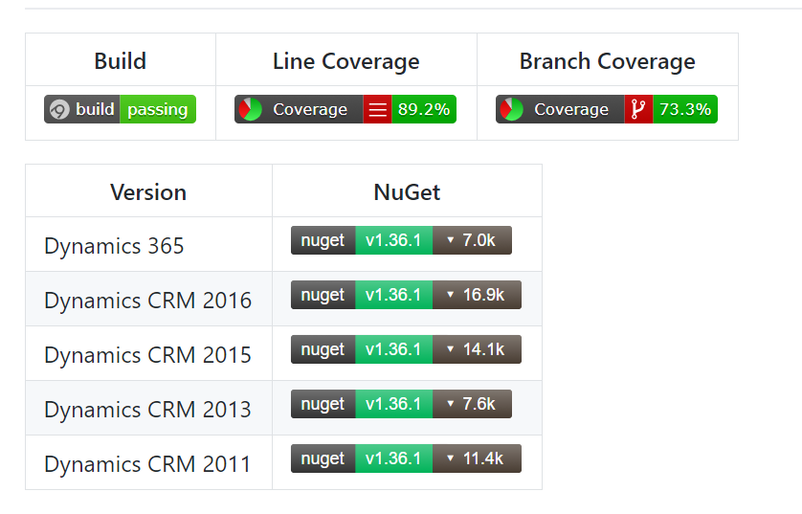
…and since then…
+56.000 downloads
134 closed issues
+60 countries

Slide 22
FakeXrmEasy: Features
Open Source (MIT)
Unit test any .net application connected to Dynamics 365
Plugins, Codeactivities, Custom Actions,…
Web Portals
Console Apps
WPF
….

Slide 23
How it Works?
1 single ctx.GetOrganizationService() call needed
Query Engine built-in running LINQ, FetchXml, QueryExpression and QueryByAttribute
Many many CRM messages already implemented

Slide 24
Lab 101: MVC Unit Testing

Slide 25
Lab Setup
Please go to this GitHub repo, fork it (create a GitHub account if you still don’t have one), and clone it locally:
https://github.com/jordimontana82/directions-emea-2017
We’ll going to use Visual Studio 2017 Enterprise, with .NET 4.6.2 as it is required by Dynamics 365 9.0 onwards.
Once you have it, you have the workshop schedule / contents in the README.md

Slide 26
Schedule
We’re going to have (if time allows) up to 3 different lab sessions:
Lab 101: Overview and MVC Backend Unit Testing
Lab 102: Plugin Unit Testing
Lab 103: CodeActivity Unit Testing

Slide 27

The free “Pint” Referendum
“Would you like to have a free pint at the end of this session?”
YES / NO

Slide 28
The free “Pint” Referendum
Who? Directions EMEA Attendees (voters)
Where? Any room at the conference (polling stations)

Slide 29
The free “Pint” Referendum
Election management system to allow officers to manage the voting process so that:
We allow any voter to vote at any room in the conference
Make sure no single person votes twice

Slide 30

The Election System
Officer
Data Model
Plugins
Workflows
…
Polling Station
MVC Web Application
Dynamics 365

Slide 31
The Data Model
Contact
(contact)
Vote
(dir_vote)
Polling Station
(dir_pollingstation)

Slide 32
DEMO TIME!

Slide 33
Lab 102: Plugins Unit Testing

Slide 34
Plugin Unit Testing
ExecutePluginWith<T>:
General purpose method
It covers pretty much any property you could inject into a plugin (Stage, Phase, etc)
GetDefaultPluginContext will initialize the whole context with default properties so that you only have to override what you need.
var plugContext = context.GetDefaultPluginContext()
context.ExecutePluginWith<MyPlugin>(plugContext)

Slide 35
Lab 103: Code Activity Unit Testing

Slide 36
Code Activity Unit Testing
ExecuteCodeActivity<T>(wfContext, inputs):
This is the catch-all method overload.
Allows to inject any property into the workflow context
And also pass input parameters
var wfContext = context.GetDefaultWorkflowContext()
context.ExecuteCodeActivity<MyCodeActivity>(wfContext)

Slide 37
Code Activity Unit Testing (Inputs)
ExecuteCodeActivity<T>(wfContext, inputs):
var inputs = new Dictionary<string, object>() {
{ "firstSummand", 2 }
};
[Input("First summand")]
public InArgument<int> firstSummand { get; set; }

Slide 38
Code Activity Unit Testing (Outputs)
ExecuteCodeActivity<T>(*)
CodeActivities might return output parameters
All the methods return a Dictionary of the output values
Again, keys in that dictionary match the CodeActivity property names:
[Output("Result")]
public OutArgument<int> result { get; set; }

Slide 39
Q & A
Want to know more?
https://dynamicsvalue.com
Barcelona
info@dynamicsvalue.com

